Slide 1
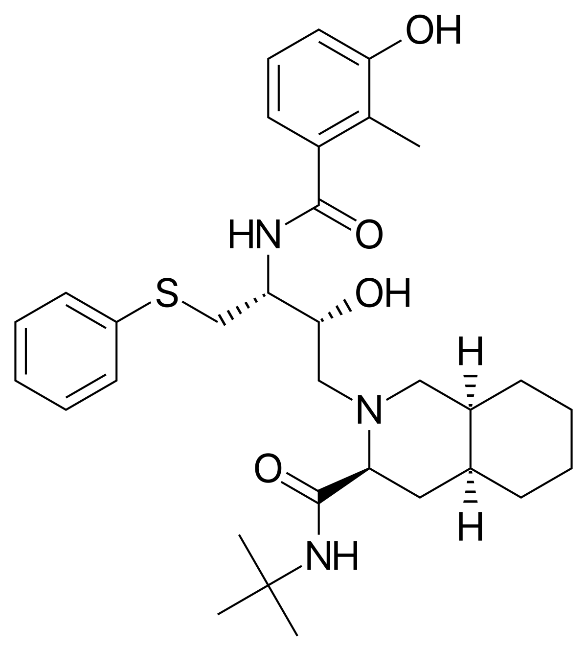
A phase I/II clinical trial of Nelfinavir plus Bortezomib + Thalidomide + Dexamethasone induction chemotherapy for newly diagnosed multiple myeloma patients eligible to autologous stem cell transplantation (NPVTD I/II trial)
CAtholic REsearch Group for Multiple Myeloma (CAREG-MM)
Seung-Hwan Shin, M.D, Ph.D.

Slide 2
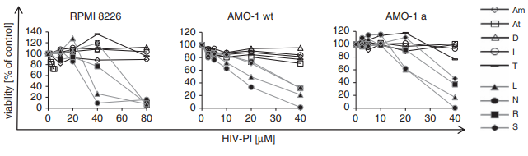
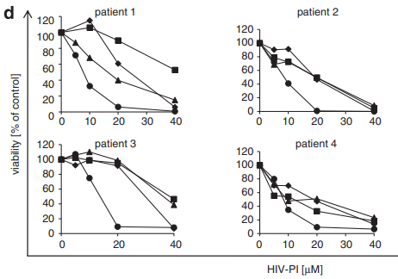
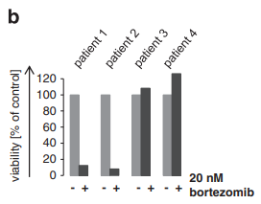
Cytotoxic activity of nelfinavir on myeloma cell lines and primary human myeloma cells
Bortezomib-sensitive
Bortezomib-sensitive
Bortezomib-resistance
All HIV-PI showed a very similar cytotoxic effect on bortezomib-sensitive vs resistant cells.
Mean IC₅₀ and IC₈₀ for nelfinavir – 9.1 µM and 15.75 µM, respectively
Blood Cancer J. 2013 Mar 1;3:e103.

Slide 3
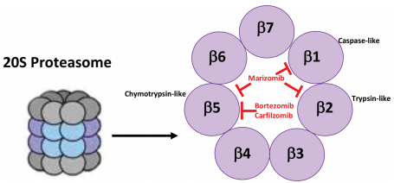
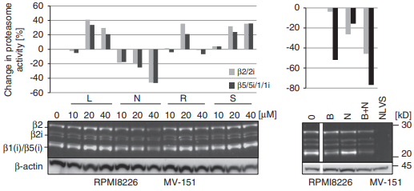
Effect of nelfinavir on different proteasome active subunits in intact myeloma cells
Independent and non-competing mechanism for β1/ β5 restricted proteasome inhibition between nelfinavir and bortezomib
Nelfinavir is pan-proteasome inhibitor that inhibits not only the β1/ β5-type of activity, but also the β2 type of activity with equal potency.
Blood Cancer J. 2013 Mar 1;3:e103.

Slide 4
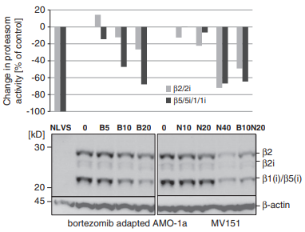
Effect of nelfinavir on different proteasome active subunits in intact myeloma cells
Nelfinavir 40 µM – significantly inhibited all active proteasome subunits including the β2 activity also in bortezomib-adapted cells
Bortezomib 10 nM + nelfinavir 20 µM – highly efficient inhibition of β2 and β1/β5 proteasome activity
Blood Cancer J. 2013 Mar 1;3:e103.

